Slide 1


1
MINI PROJECT
IOT-SMART PARKING SYSYTEM
DONE BY
> M.HITESH YADAV-111619106089
> PYDA SRI SAI VENKATA RAVI CHANDRA-111619106107
> LOKESH POLAVARAM-111619106072
> PRABAKARAN V-111619106102

Slide 2
INDEX
2
Intoduction
Circuit model
Advantages/Apllications
Components
Working model
Conclusion

Slide 3
3
INRODUCTION
The goal of parking sytem project is to reserve parking spot for a car/vehicle before it arrives.
One of the most problems that the driver faces is finding a free parking spot, so many driver stopping their cars at the edges of the street.
Therefor, We choose this to prevent the frustration of finding a parking spot and they can reserve a spot when they stay at home.

Slide 4
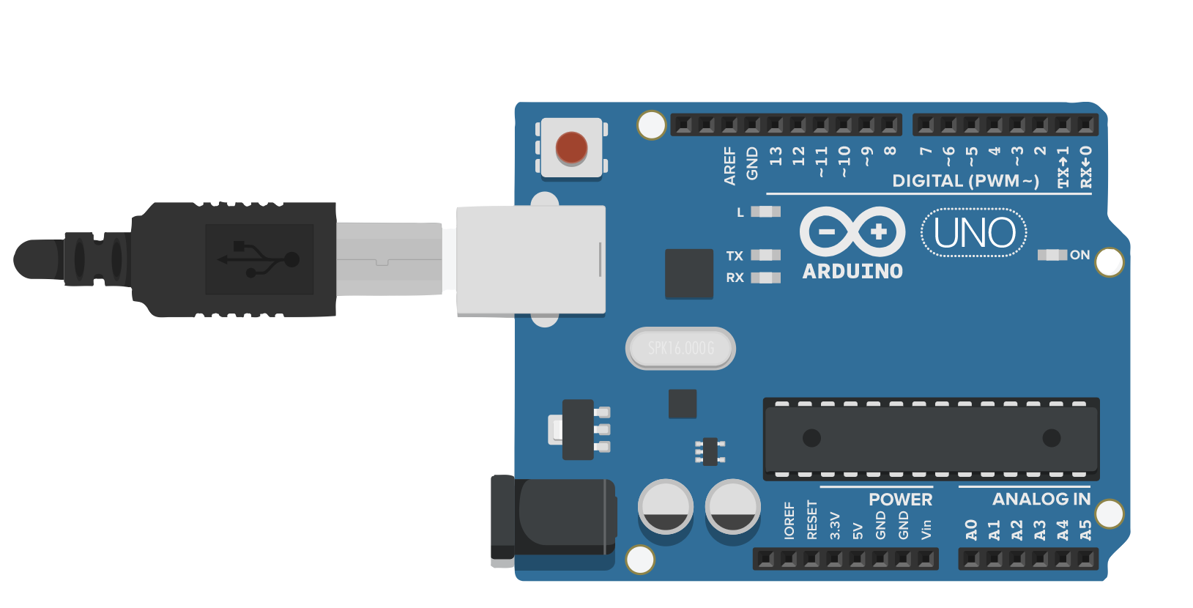
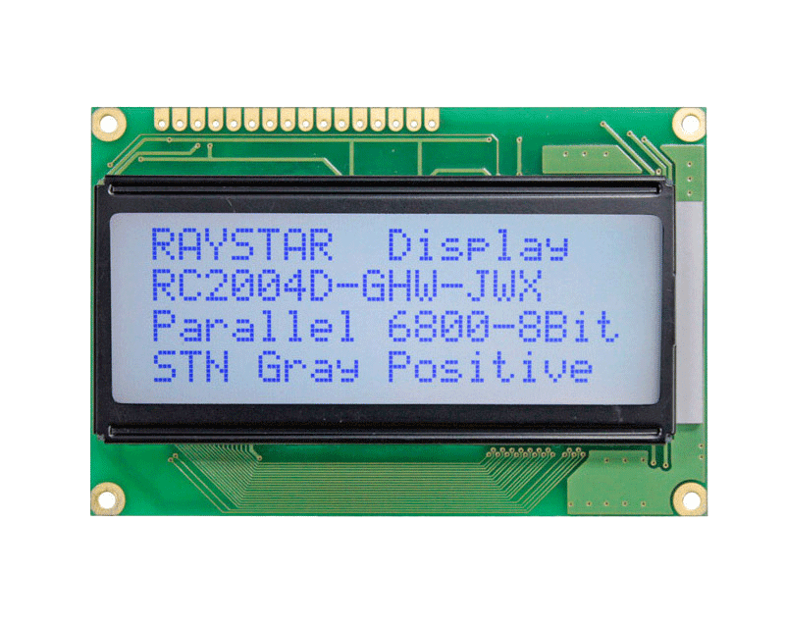
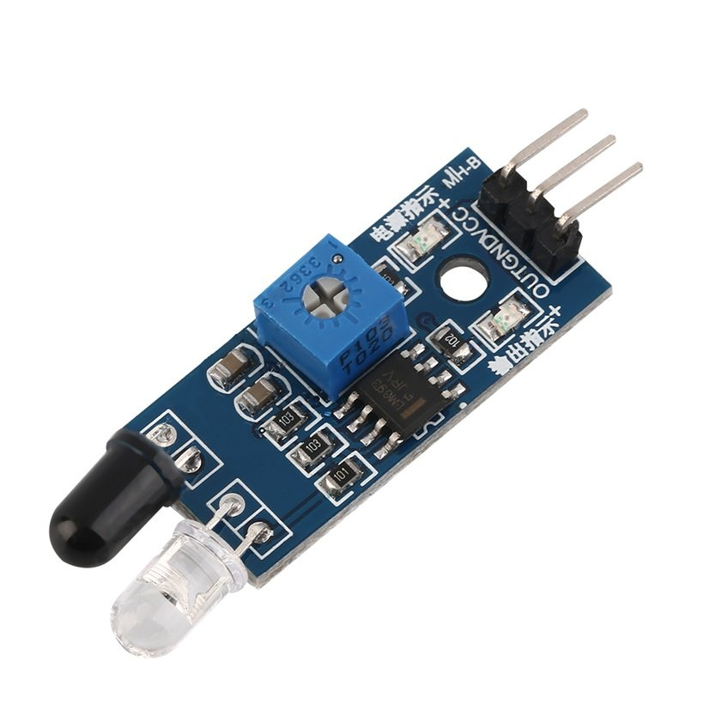
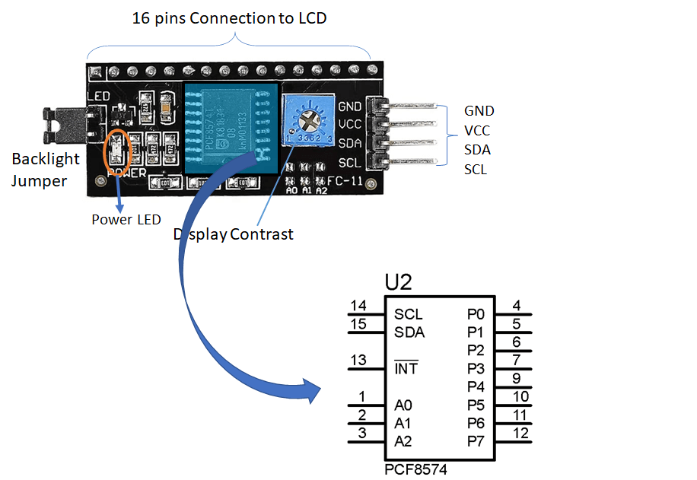
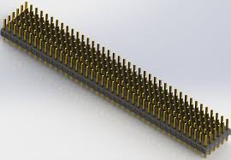
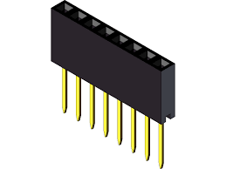
Components
4
Arduino Uno
20×4 LCD Display
I2C LCD Module
Female and Male Headers
Male Header

Slide 5
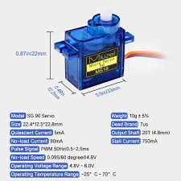
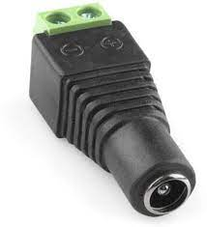
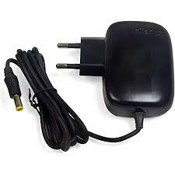
5
Mini Servo SG-90 Motor
5V,2Amp power Adaptor
Female Dc power jack

Slide 6
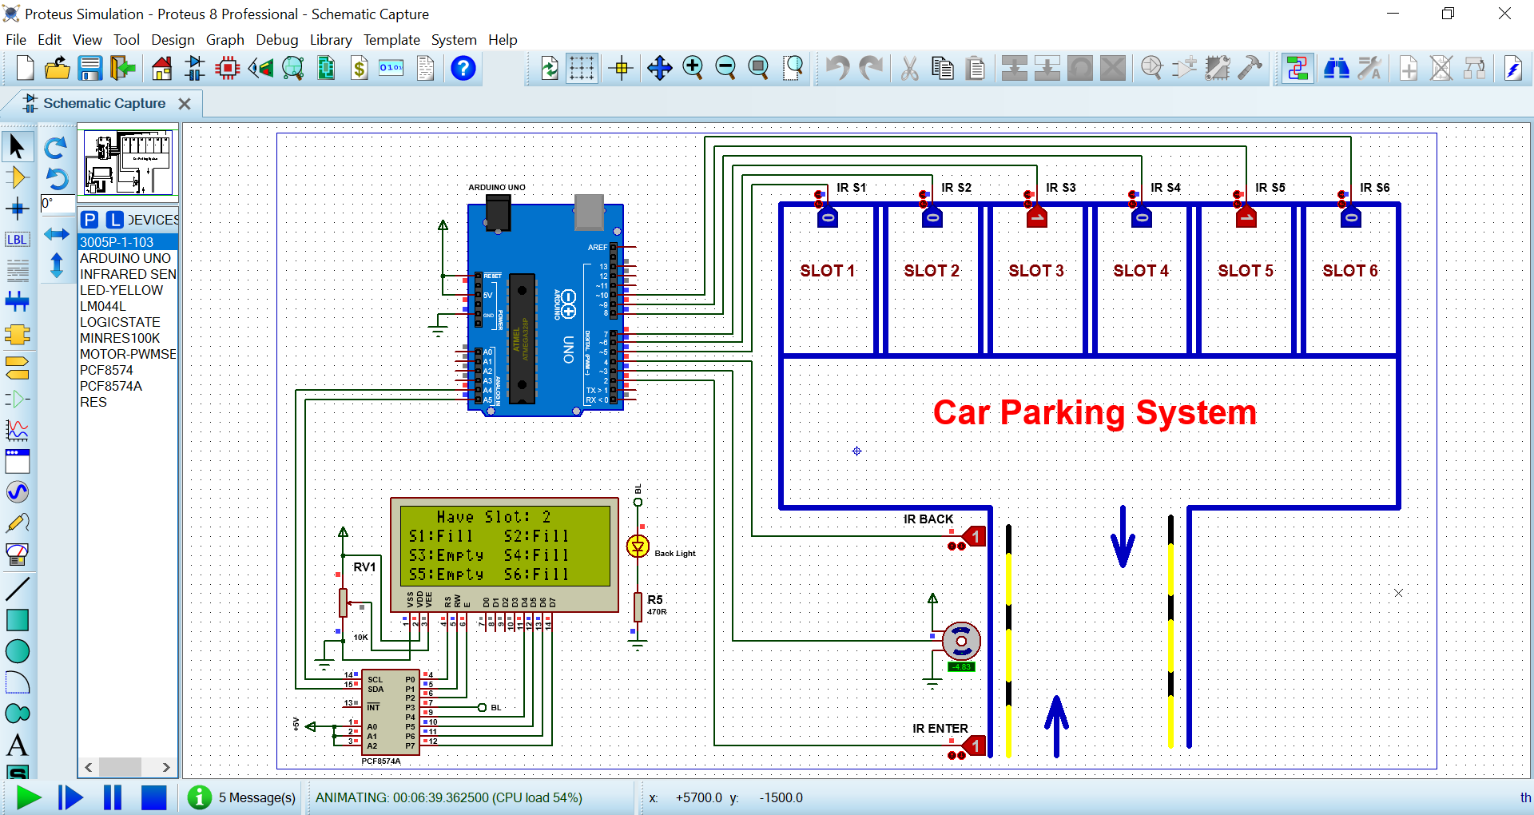
6
Circuit diagram

Slide 7
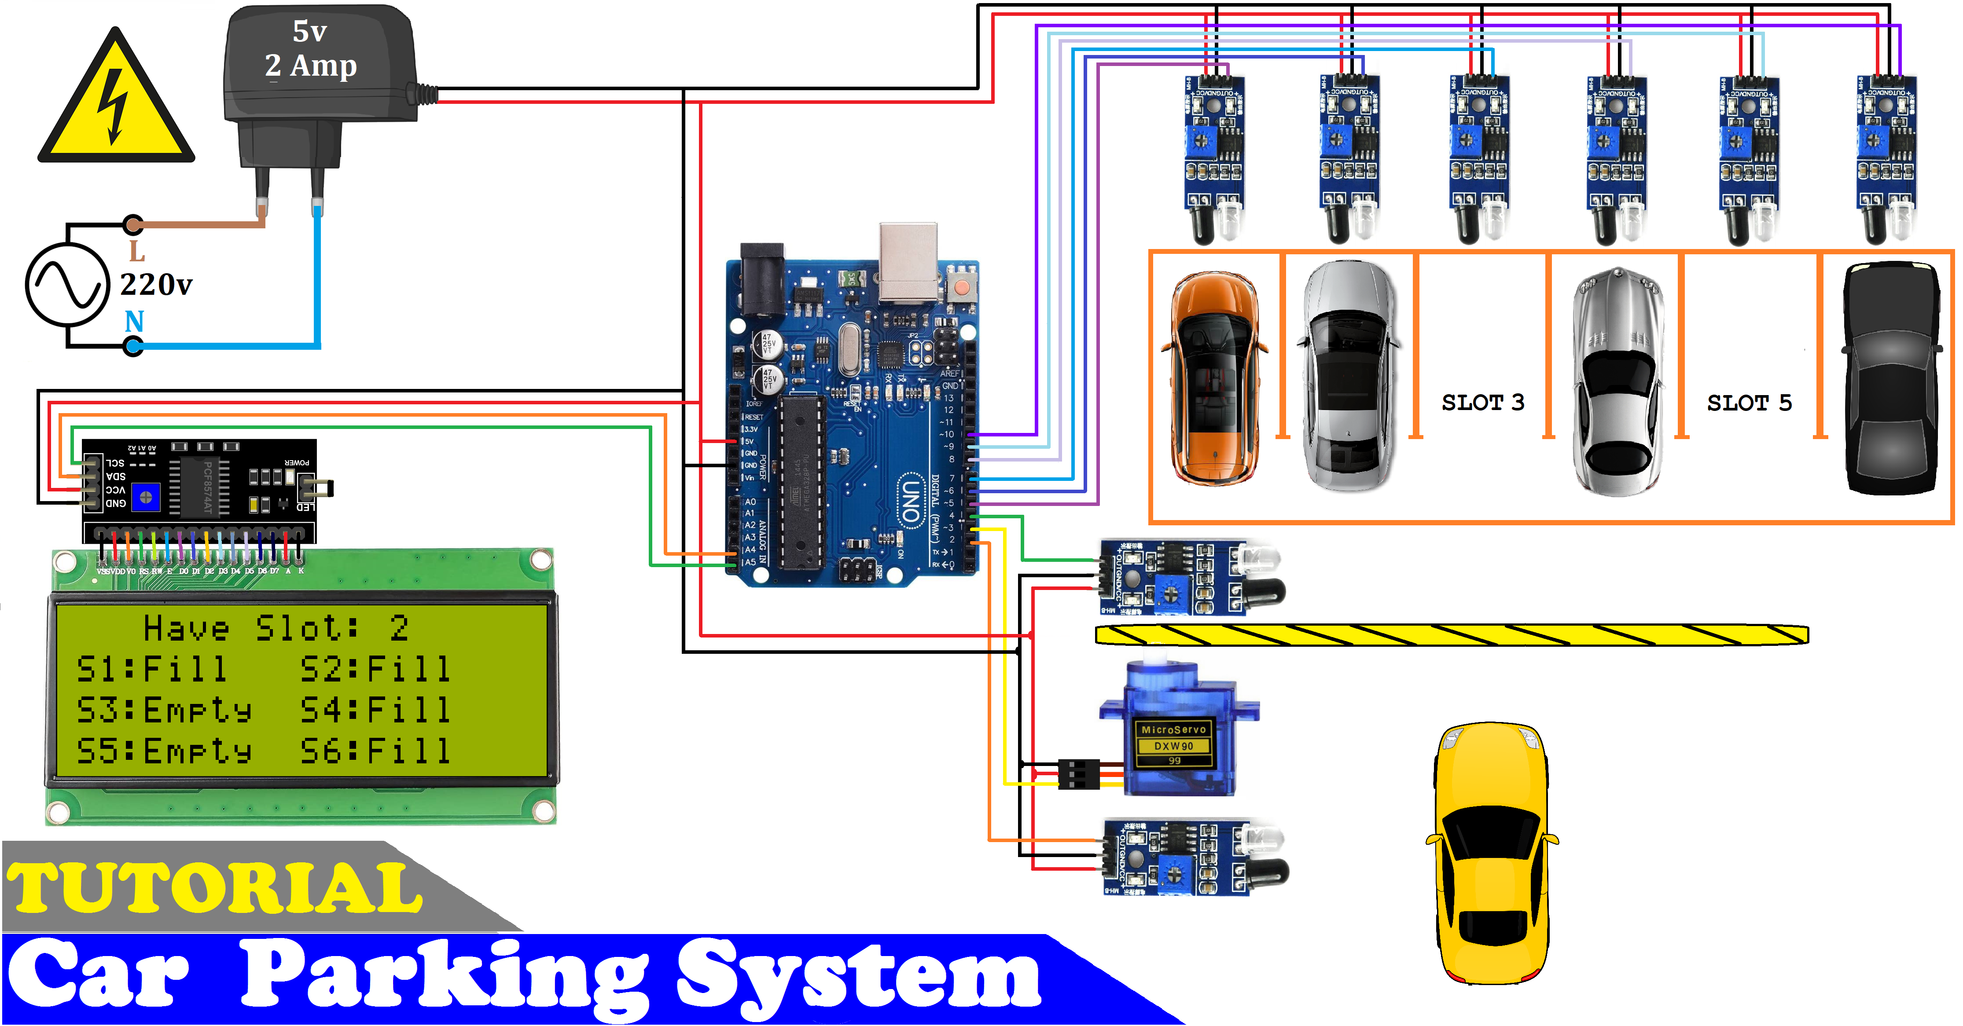
Working Model
7
Working of

Slide 8
Smart parking development implies an IoT-based system that sends data about free and occupied parking places via web/mobile application. The IoT-device, including sensors and microcontrollers, is located in each parking place. The user receives a live update about the availability of all parking places and chooses the best one.
In order to investigate technologies behind the smart parking solution, we implemented an internal research project. The main idea was the creation of smart parking using the Internet of Things and ultrasonic sensors, where available parking places could be displayed in a web application.
8
WORKING PROCESS

Slide 9
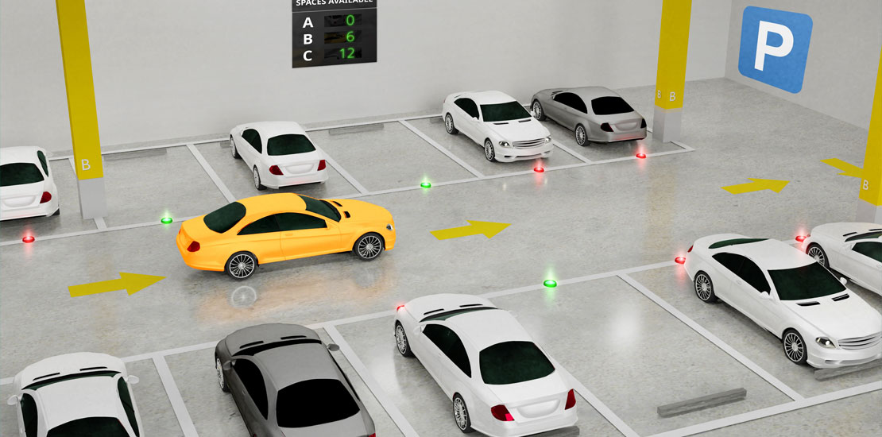
<Advantages>
9
Shorter waiting Time
Save fuel
Guided to nearest place
Reduce carbon emission

Slide 10
<Applications>
10
Smart parking system can be implemented
Shopping Malls
Theaters
Airports
Restaurents

Slide 11
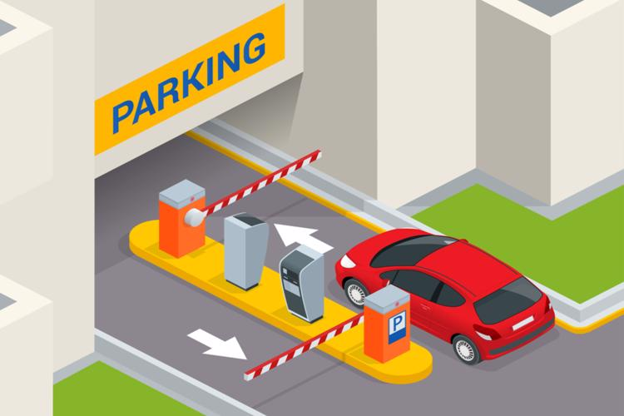
11
Future Scope
The future of the smart parking system is expected to be significantly influenced by the arrival of automated vehicles (AVS). several cities Around The World are already beginnig to trial self-parking vehicles, specialized AV parking lots, and robotic parking Valets

Slide 12
12
Conclusion
The system benefits of smart parking go well beyond avoiding time wasting.
Developing a smart parking solutions with ina city solves the pollution problem.

Slide 13

THANK YOU

